Slide 1

Using patient-derived tumour xenograft models to study metastasis expression in vivo
A. Martin - Data presentation – 6/10/17

Slide 2
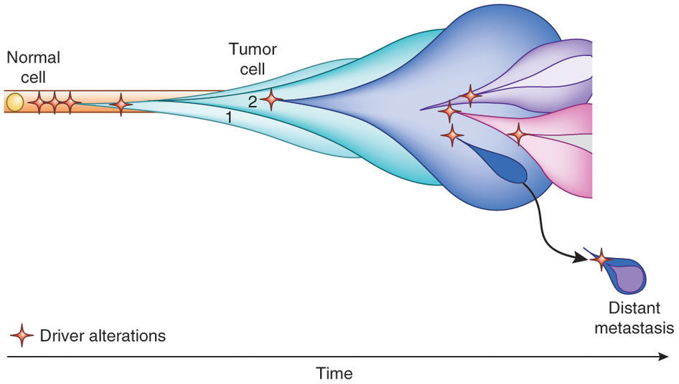

Metastasis Background
Ash A Alizadeh et al, Nature Medicine, 2015

Slide 3
Metastasis Background
… no clear relationship has emerged between the mode of metastatic progression (linear vs parallel, monoclonal vs polyclonal, or monophyletic vs polyphyletic) and the characteristics of the primary tumor, including tumor type and other clinical features. To data, there is little compelling evidence for the existence of specific metastasis-driving genes, with the exception of TP53….
- Turajlic & Swanton 2016

Slide 4
Overview of PDTX models
Total PDTX models | 149
PDTX models from primary samples | 95
PDTX models from metastatic samples | 46
Models exhibiting metastasis in the mouse | 11
Models that have metastasised to multiple locations in the mouse | 2
PDTX models from matched patient primary and metastatic samples | 6
Looking for PDX models that metastasises regularly; ideally to multiple sites.
If possible, matched data from patient (normal, primary and met).

Slide 5
PDTX model: AB861
Patient details
Age at surgery: 63
Type: Lobular
Subtype: ER+/PR+/HER2-
Mets: Lymph node (post-op: bone)
Treatment: Letrozole/Tamoxifen
Status: Alive

Slide 6
PDTX model: AB861

Slide 7
PDTX model: AB861

Slide 8
PDTX model: AB861
Are there any differences between the tumours that did and did not metastasise?

Slide 9
PDTX model: AB861
Considering each passage individually, are there any differences between the tumours and lymph node mets?

Slide 10
PDTX model: AB861
Immediate experiments:
Genomic changes:
Analysis of exome-sequencing data
Targeted sequencing of ctdna
Transcriptomic changes:
Analysis of RNA-sequencing data
Epigenetic changes:
Analysis of ChIP-seq (H3K27ac)
Route of metastatic spread:
Tail vein injection of tumour cells
Cardiac injection of tumour cells
Phenotypic differences:
Drug screens comparing metastatic and non-metastatic samples, early vs late passages etc.

Slide 11
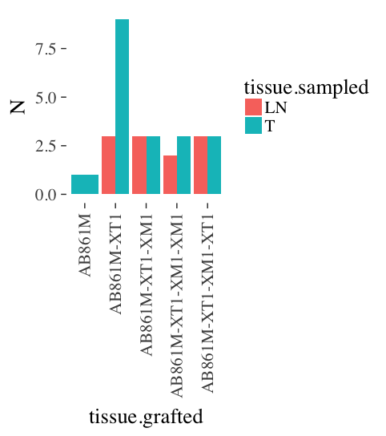
RNA-seq dataset overview
3 patient samples
(normal, primary & met)
30 PDTX samples
paired LN-T where possible
Tissue.grafted notation:
AB861M → Primary engrafted
[*code*]-XT1 → Primary of prior PDX
[*code*]-XM1 → Met of prior PDX

Slide 12
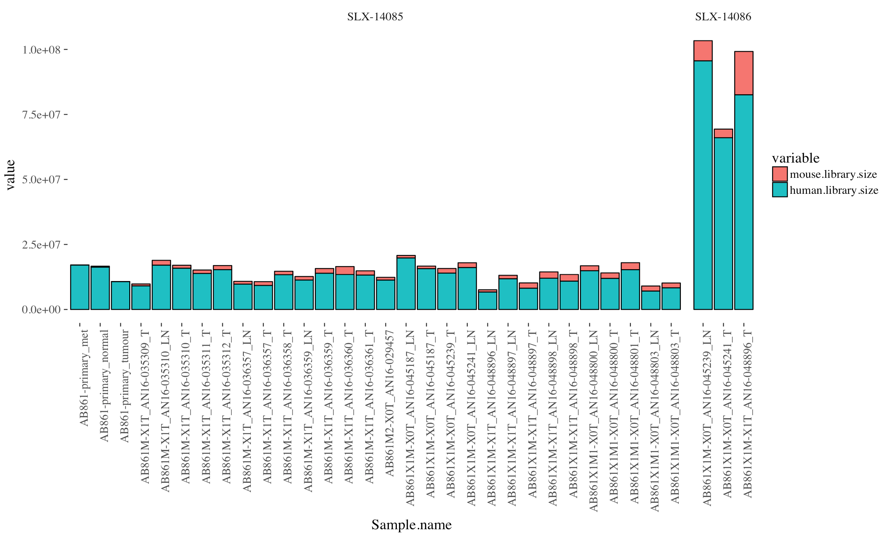
RNA-seq dataset overview

Slide 13
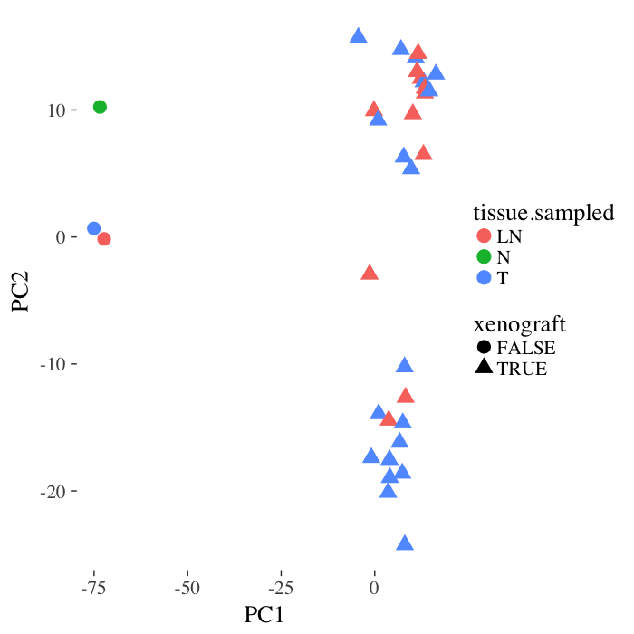
RNA-seq dataset overview

Slide 14
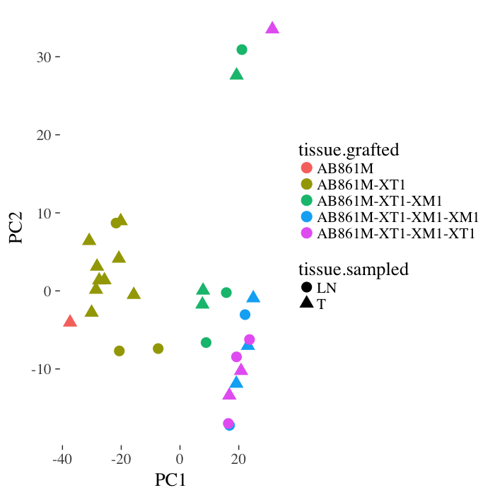
RNA-seq dataset overview

Slide 15
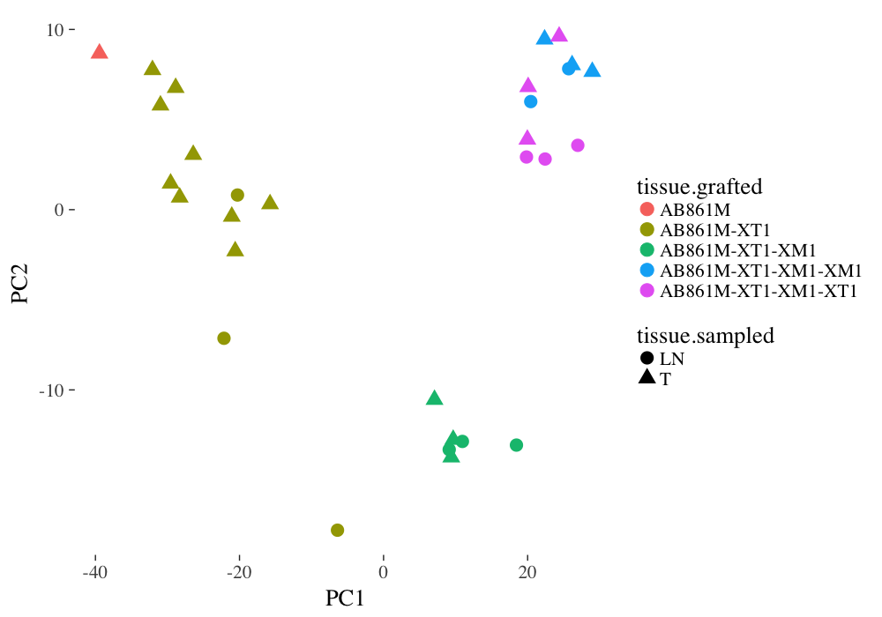
RNA-seq dataset overview

Slide 16
Q1: Are there any differences between the tumours that did and did not metastasise?

Slide 17

Q1: Are there any differences between the tumours that did and did not metastasise?

Slide 18
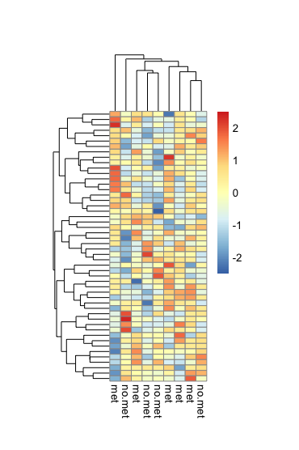
Q1: Are there any differences between the tumours that did and did not metastasise?

Slide 19
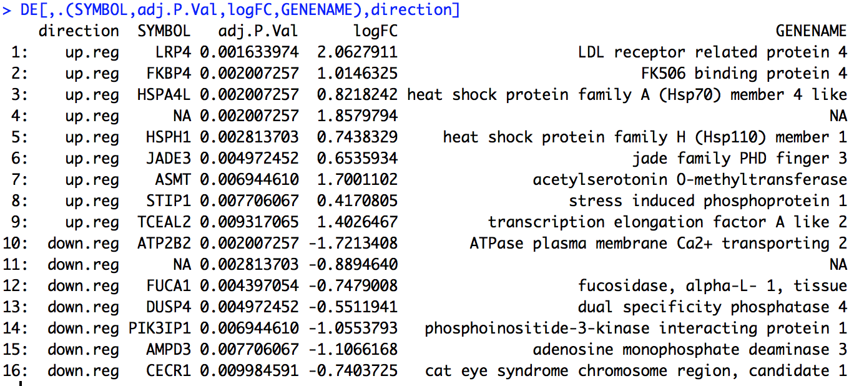
Q2: Are there any differences between the tumours and lymph node mets?
Model 1: ~ tissue.sampled + tissue.grafted + (batch)

Slide 20
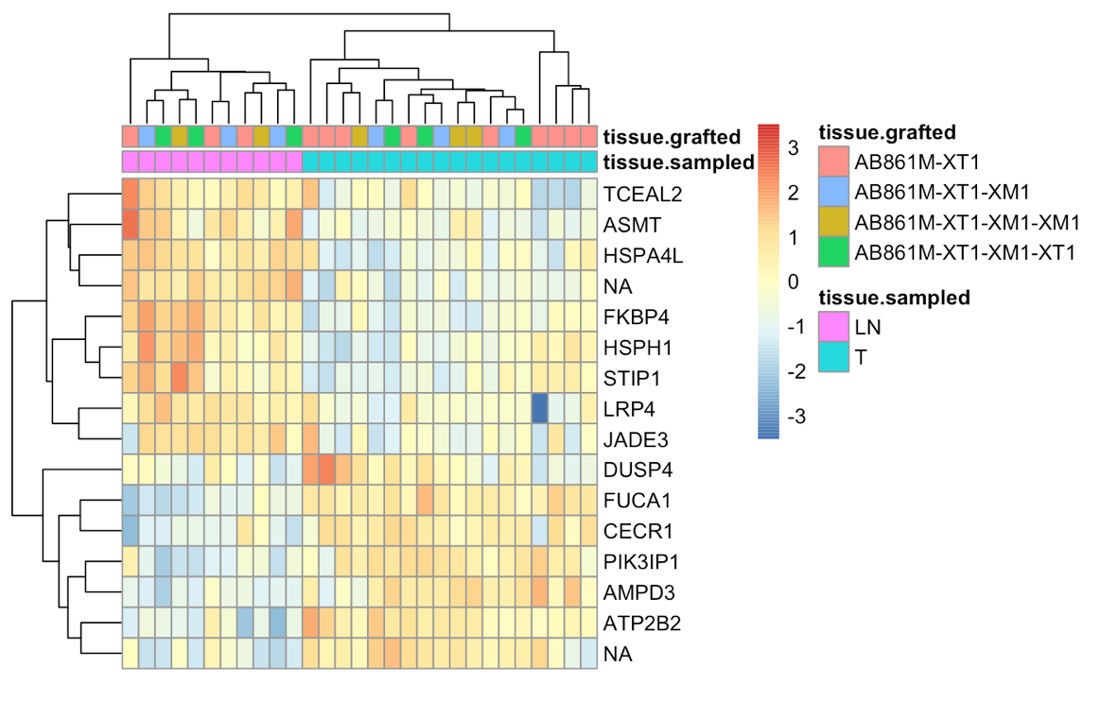
Q2: Are there any differences between the tumours and lymph node mets?
Model 1: ~ tissue.sampled + tissue.grafted + (batch)

Slide 21
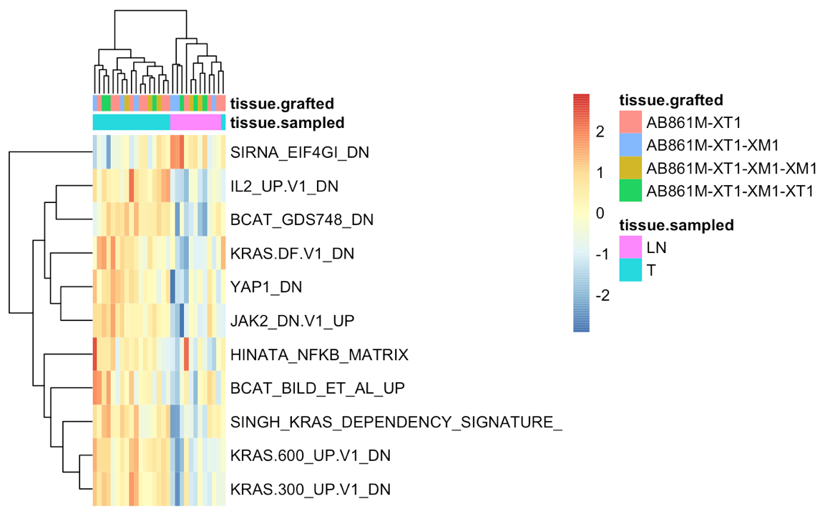
Q2: Are there any differences between the tumours and lymph node mets?
Model 1: ~ tissue.sampled + tissue.grafted + (batch)

Slide 22
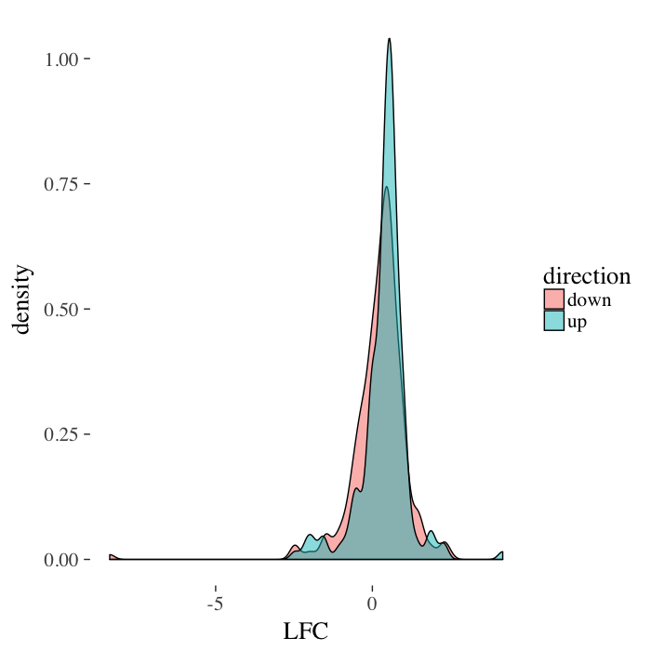
Q2: Are there any differences between the tumours and lymph node mets?
Model 1: ~ tissue.sampled + tissue.grafted + (batch)

Slide 23
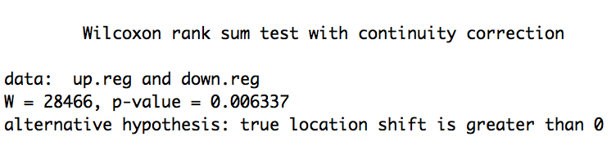
Q2: Are there any differences between the tumours and lymph node mets?
Model 1: ~ tissue.sampled + tissue.grafted + (batch)

Slide 24
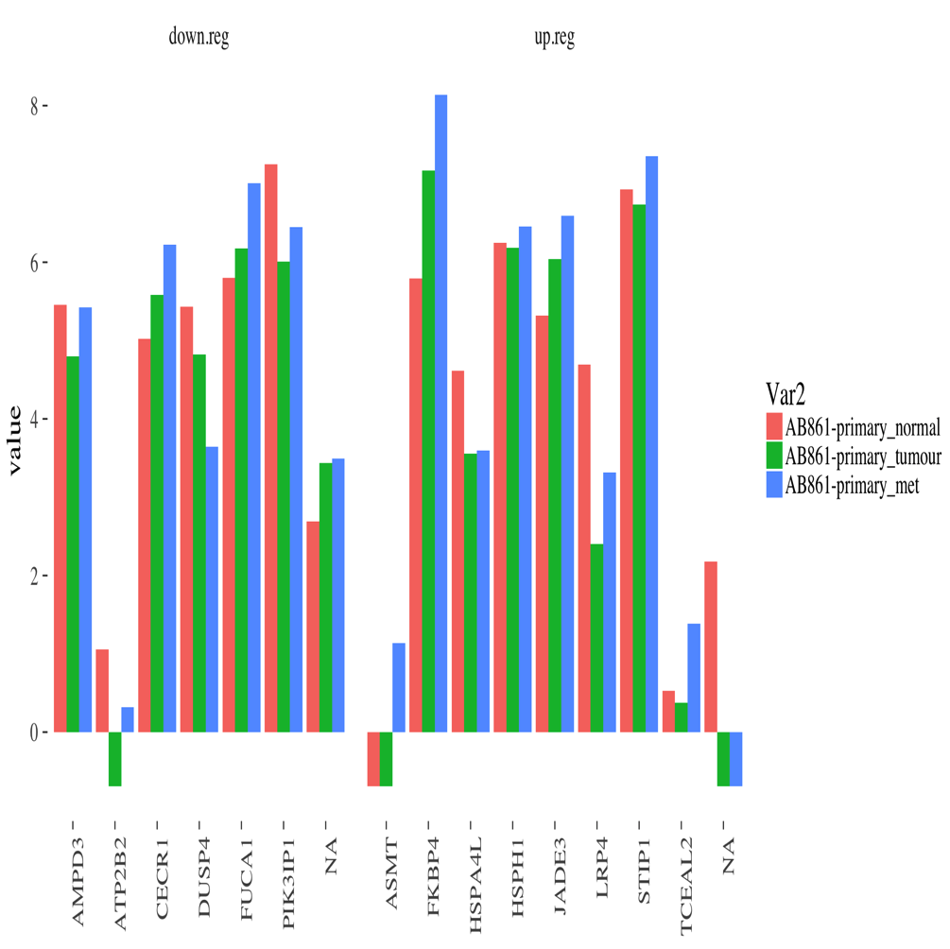
Q2: Are there any differences between the tumours and lymph node mets?
Model 1: ~ tissue.sampled + tissue.grafted + (batch)

Slide 25
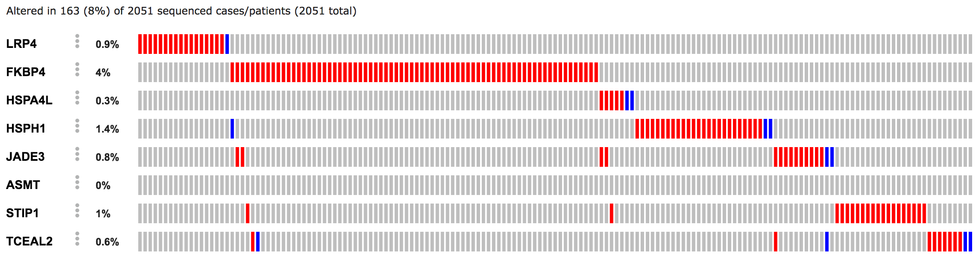
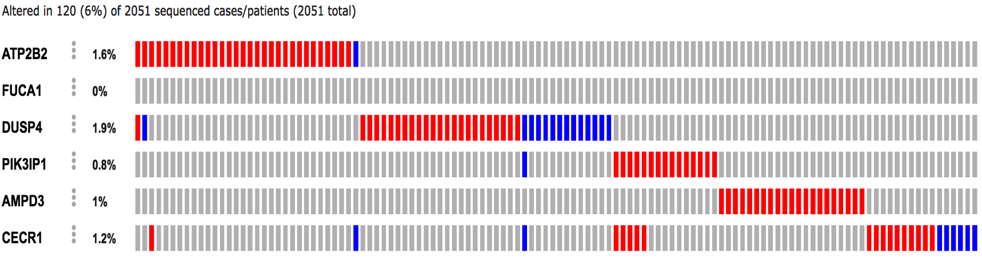
Q2: Are there any differences between the tumours and lymph node mets?
Model 1: ~ tissue.sampled + tissue.grafted + (batch)
Up
Reg
Down
Reg

Slide 26
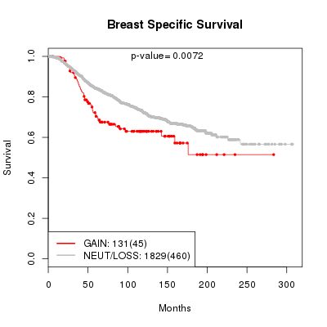
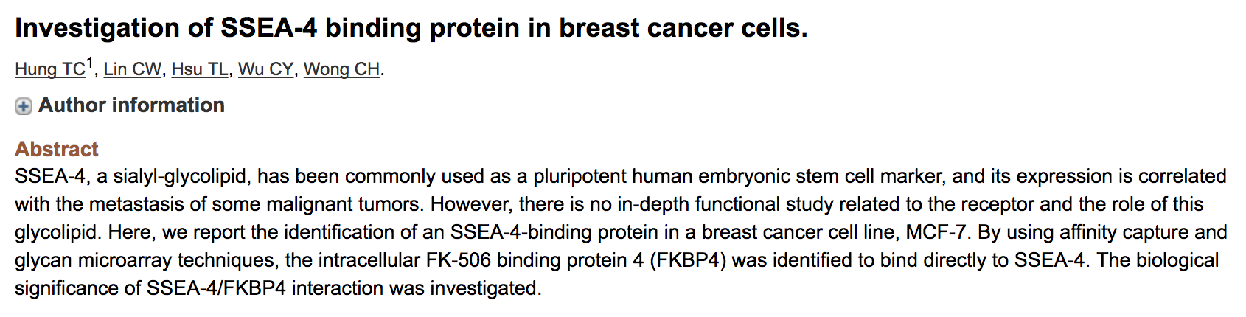
Q2: Are there any differences between the tumours and lymph node mets?
Model 1: ~ tissue.sampled + tissue.grafted + (batch)
FKBP4

Slide 27
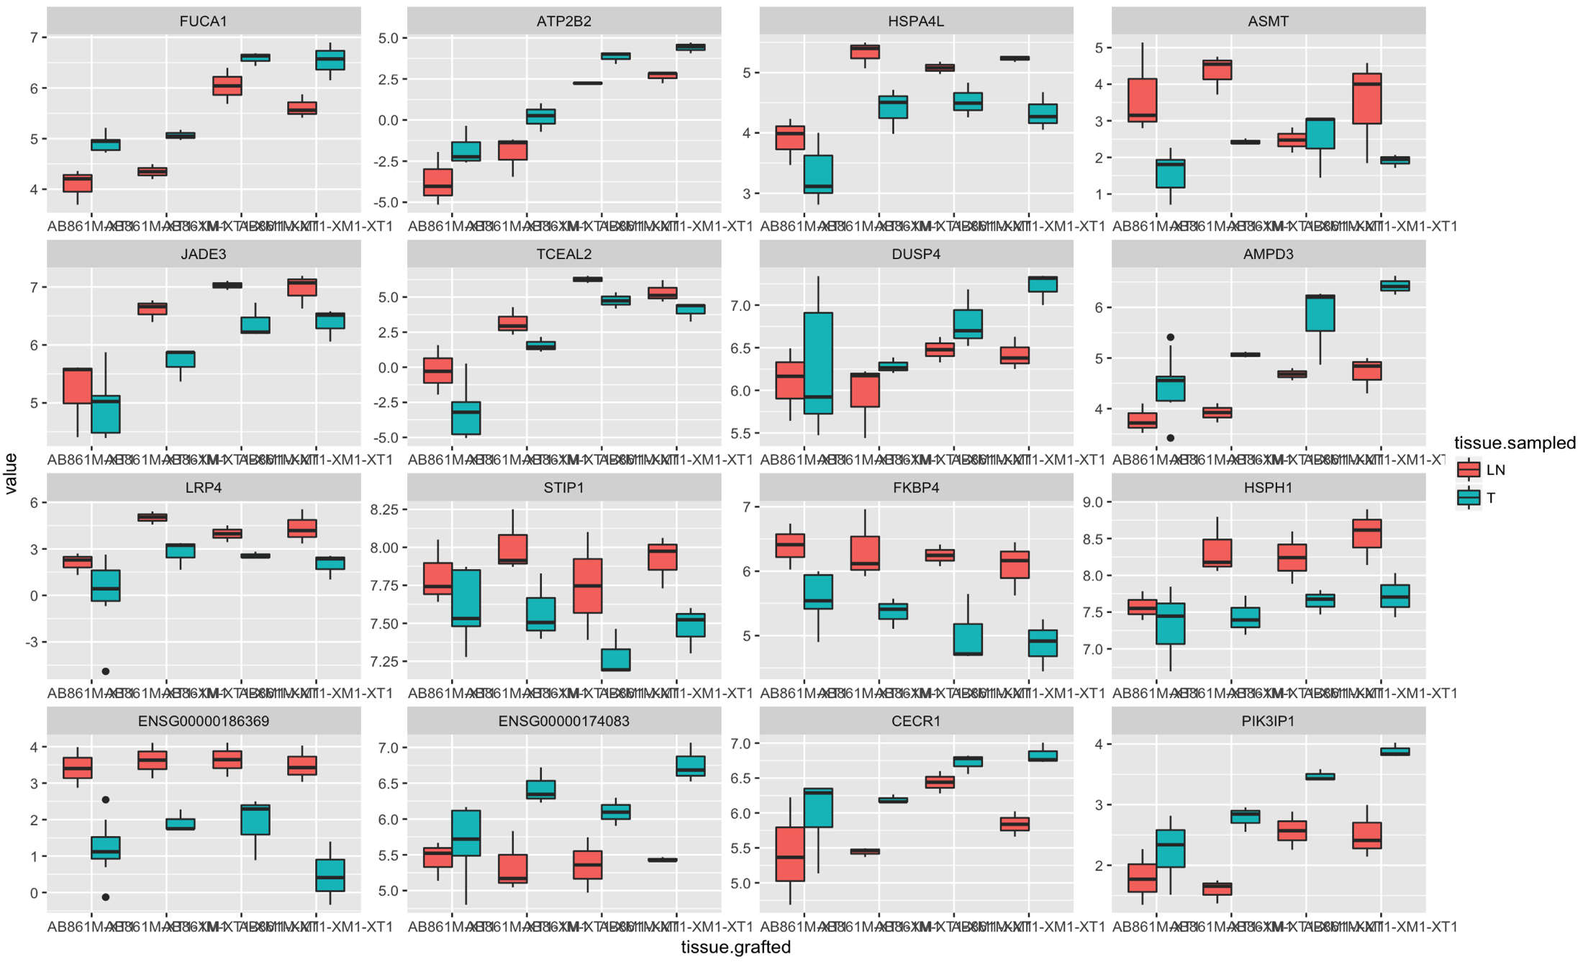
Q2: Are there any differences between the tumours and lymph node mets?
Model 1: ~ tissue.sampled + tissue.grafted + (batch)

Slide 28

Next steps
Interaction terms
Requires more samples
~ tissue.sampled*tissue.grafted + (batch)
Analysis of patient data
Sequencing more sections of the primary
Exome Analysis
Investigate clonal phylogeny
Multi-region Sampling
Analysis of a second PTDX model
… and figure out the biology

Slide 29
Acknowledgements
Caldas group
Carlos
Alex
Oscar
Abby
Mau
Dimitra
Ankita
CRUK Core
Genomics
BRU
Microscopy
Histology
Breast Cancer Unit

